Slide 1
Introduction to XSS
Unit 18.2
Cybersecurity Boot Camp |
November 27, 2018

Slide 2

JavaScript enables interactivity…
Notes:
Explain that, while JavaScript is used for a multitude of tasks, the motivation for its invention was the desire to add interactivity to web pages.
Explain that JavaScript is the magic that allows us to create games, animations, and high-tech dashboards in the browser.

Slide 3

…But expands our attack surface
Notes:
While powerful, the ability to make interactive pages that talk to the network has considerable security implications.
The majority of attacks involving the front-end web use JavaScript as the attack vector.

Slide 4
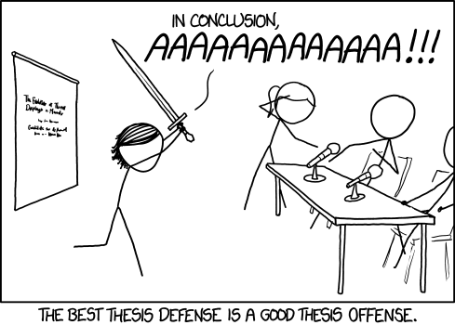
Notes:
XKCD reminds us that understanding attackers’ tools is the best way to stop them dead in their tracks…
So, today, students will study how to find and exploit XSS vulnerabilities.

Slide 5
Today’s Goals
By the end of class, you will be able to:
Articulate common malicious uses of JavaScript
Explain how reflected and persistent XSS are delivered
Manually identify and exploit XSS vulnerabilities
Construct “syntax-breaking” XSS payloads
Notes:
Read the objectives off the slide to set expectations.

Slide 6
Manipulating HTML with JavaScript
Notes:
- Let students know that this week's lessons will focus on web vulnerabilities.
- Explain that you'll study a vulnerable web application running on a LAMP stack similar to what students built last week.

Slide 7
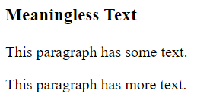
The Raw and the Rendered
RAW MARKUP
<section>
<h3 id=“heading”>Meaningless Text</h3>
<p>This paragraph has some text.</p>
<p>This paragraph has more text.</p>
</section>
RENDERED
Notes:
Remind students that browsers interpret markup by reading HTML, and then rendering it according to internal rules and CSS styles.

Slide 8
The DOM
section
p
h3
p
textContent
textContent
textContent
This paragraph
has some text.
Meaningless Text
This paragraph
has more text.
id
heading
Notes:
Explain that browsers begin loading pages by reading their HTML As they do, they keep detailed records of:
Which tags appear on the page, and the values of their attributes
Which elements each tag is related to (i.e., the browser remembers that the p tags are inside the section tag, in this example)
Explain that this “record”, or “memory”, is called the Document Object Model, or DOM.
Explain that, after a browser finishes reading the HTML and building its record of the DOM, it renders the page.
Explain that, after this, we can use JavaScript to update the browser’s internal “record” of the page (i.e., the DOM).
Explain that, when the browser detects a change in the DOM, it automatically updates the page.

Slide 9
Manipulating Elements
1 JavaScript
const heading = document.querySelector(‘#heading’)
console.log(heading.textContent) // “Meaningless Text”
heading.textContent = “Meaningful Nonsense”
2 DOM
Meaningless Text
Meaningful Nonsense
section
h3
textContent
3 Rendered
Meaningful Nonsense
This paragraph has some text.
This paragraph has more text.
Notes:
For now, explain that this snippet:
Selects the element on the page with `id=heading`.
Prints out the element’s text (“Meaningless Text”)
Changes the text inside the element to “Meaningful Nonsense”
Emphasize that this code changes the DOM. In particular, it updates the record for our heading such that it contains the text “Meaningful Nonsense”, instead of “Meaningless Text.”
Explain that, after the browser realizes the DOM has been updated, it repaints the page to reflect the changes.

Slide 10
Widgets
Animations
UI Elements
Notes:
Explain that code like this can be used to achieve some sophisticated effects:
Updating an elements text every second allows us to make a clock
Advanced techniques let us update the page so quickly we can achieve high-quality animations
Using JS to respond to user clicks on menu icons allows us to make intuitive UI elements for better user experience

Slide 11
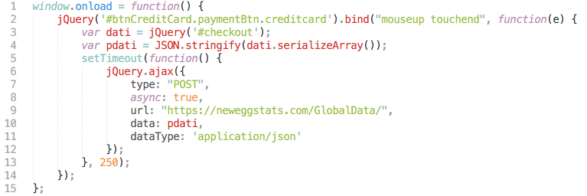
Manipulating elements is powerful…
But also deadly.
Notes:
Point out that, in addition to these legitimate uses, attackers can program more malicious interactions…
Explain that, in this snippet from the earlier NewEgg article, the attacker has selected the element with id `#btnCreditCard`. Instead of repainting a pretty menu, this code sends the user’s credit card number to the hacker’s servers as they type it.
Let students know that we’ll understand each line of this function on Saturday.
Emphasize that, for now, the takeaway is that being able to modify the page allows us to build rich interactive experiences, but also opens numerous avenues of attacks.

Slide 12
Cross-Site Scripting // XSS
Notes:
Let students know that you’ll now turn to exploring how JavaScript’s DOM updates can be leveraged for malicious purposes.

Slide 13
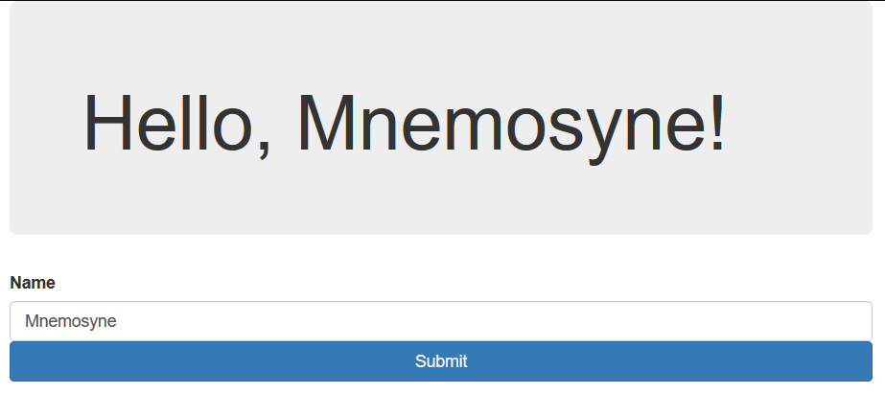
JavaScript is often used to update HTML
based on user input.
Notes:
Explain that, in addition to the examples of interactivity previewed earlier, JavaScript is often used to update the page based on a user’s input.

Slide 14
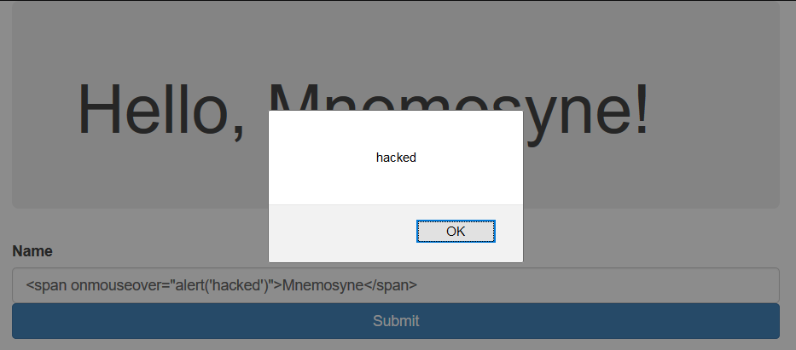
But attackers can use inputs to submit
malicious XSS payloads (!)
Notes:
This adds interactivity, but at the cost of vulnerability.
Attackers can submit malicious HTML instead of “expected” input, causing the web application to behave in unexpected ways.
In this example, a user added an HTML element that causes JavaScript to execute when the user passes their mouse over the name Mnemosyne!
In a real attack, the attacker could have sent the user’s private cookie data to a malicious server, without the user seeing a pop-up or any other evidence of exploitation.

Slide 15
Manipulating Elements
1 JavaScript
const heading = document.querySelector(‘#heading’)
console.log(heading.textContent) // “Meaningless Text”
heading.innerHTML = `<span onmouseover=“alert(‘hacked’)”>
Meaningful Nonsense</span>`
2 DOM
<span
onmouseover=
“alert(‘hacked’)”>
Meaningful Nonsense
</span>
section
h3
innerHTML
3 Rendered
Meaningful Nonsense
This paragraph has some text.
This paragraph has more text.
Notes:
Explain that, if JavaScript is used to modify the HTML of an element (instead of its text), attackers can dump malicious, executable code into the web page.

Slide 16
XSS is a threat anywhere that user input is inserted into an HTML document.
Notes:
Emphasize that XSS is a threat anywhere that user input is reflected into an HTML document.
…Anywhere.

Slide 17
There are three main flavors of XSS:
Reflected | User input is echoed to page from a request.
Persistent | Malicious script is loaded from database.
DOM-Based | Exploitation of a client-side script via
| manipulation of the DOM.
Notes:
Explain that there are three main varieties of XSS.
Explain that the main types of XSS students need to understand are Reflected and Persistent XSS.

Slide 18
In Reflected and Persistent XSS, the payload is contained in the server’s response.

Slide 19
In DOM-Based XSS, a benign client-side script is made to behave maliciously.

Slide 20
Today’s lesson will focus on Reflected and Persistent XSS.

Slide 21
Reflected XSS

Slide 22
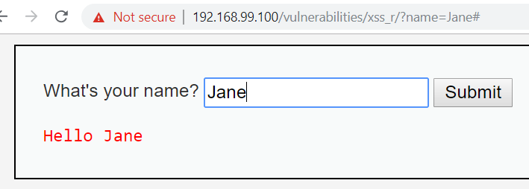
Reflection
Web apps can send user input
to the server via query params.
These params are then used
to generate the HTML response.
Notes:
Explain that user input from forms is often sent to servers via GET query parameters (as you see in the URL bar).
The server uses these query parameters to generate the HTML page it sends back ( as you see in “Hello Jane”, at the bottom).

Slide 23
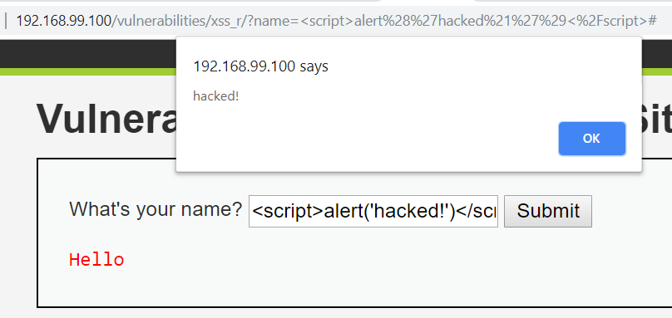
Reflection
XSS results when the server includes
malicious JavaScript in its response.
Notes:
However, if a user sends JavaScript instead of expected text, the server will add the malicious script to the page—and it will execute when it gets to the client!

Slide 24
Reflected XSS attacks are typically delivered by poisoning the query string, then phishing victims with the poisoned link.
Notes:
Point out that this attack only worked because you were able to “poison” the URL.
Explain that reflected XSS is usually exploited by
Finding a vulnerable page
Injecting a payload into the query parameter
Sending the URL to a victim, who will compromise themselves when they click the link

Slide 25
Reflected XSS attacks are only threats to those who click the poisoned link.
Notes:
Emphasize that reflected XSS only affects those who click the poisoned link.

Slide 26
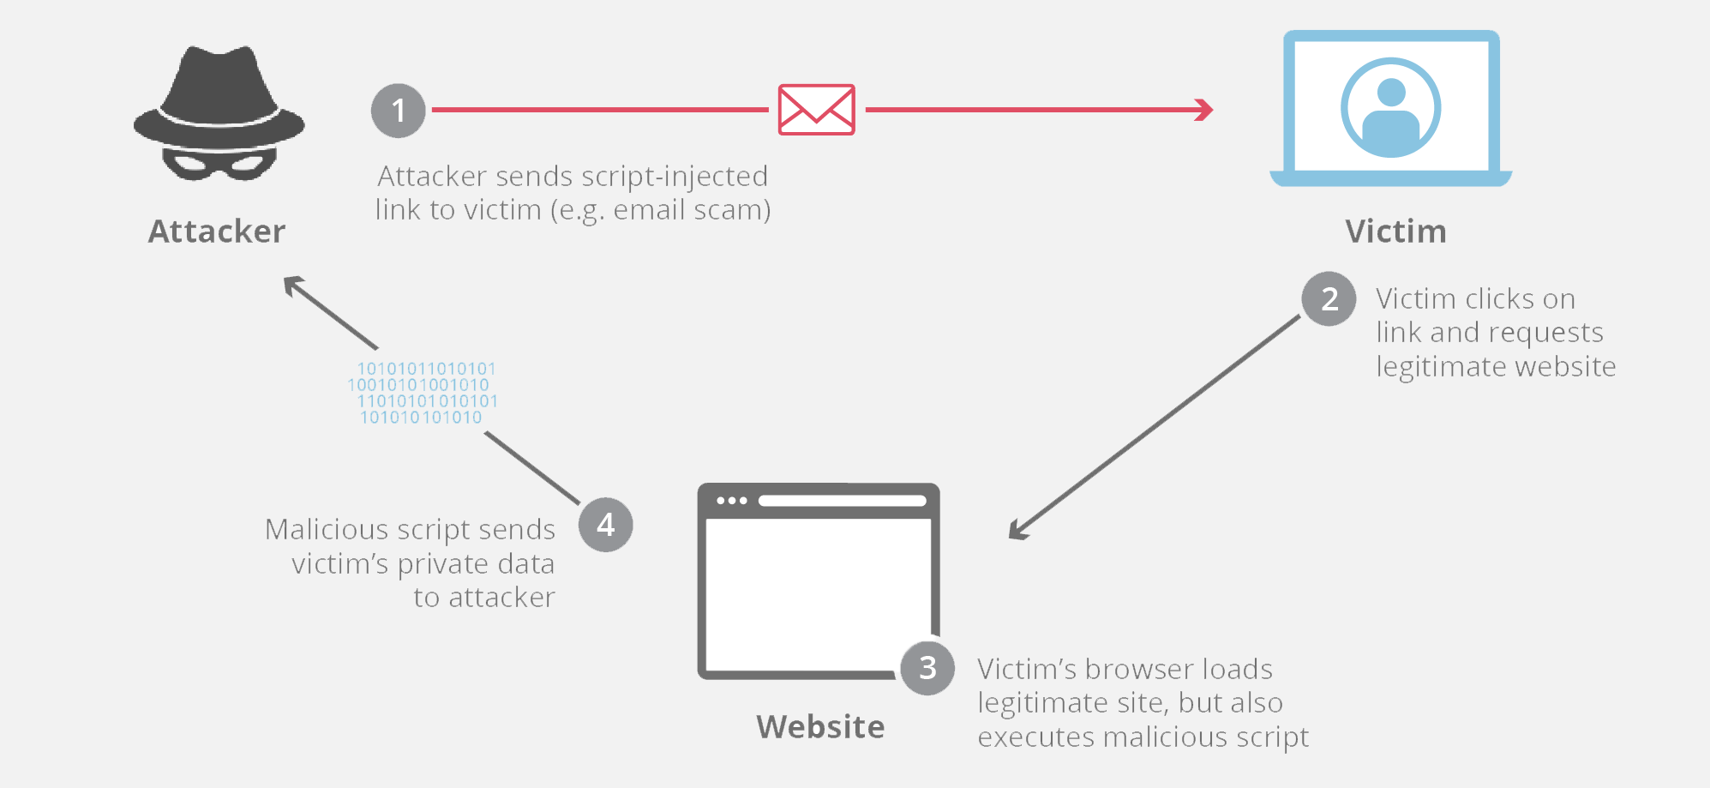
Poisoned Links

Slide 27
Demo
‘Reflected XSS’
Notes:
Reflected XSS
- Let students know that you'll begin by demonstrating reflected XSS attacks.
- Remind students that, in a reflected XSS attack, an application inserts user input from a URL or request into a page as HTML.
- Navigate to XSS Game at: <https://xss-game.appspot.com/level1>
- In the search bar, type: `hello`, then press **Search**.
- Emphasize that the search term appears:
- On the error page
- In the URL query parameters
- Emphasize that this _reflection_ of user input into the page is a major vulnerability.
- Remind students that the first step in searching for reflected XSS is to test if you can insert HTML, instead of normal text.
- Click **Try Again** to return to the vulnerable application's home page, then submit: `<h1>haxxed</h1>`
- Point out that this inserts the word `haxxed` as an HTML heading—_not_ "normal text"!
- Explain that this tips us off to the possibility of injecting a script tag. Enter: `<script>alert('you got hacked!')</script>`, and emphasize that the browser executes this JavaScript!
- Emphasize that students don't need to be able to write malicious JavaScript themselves—they simply need to be able to find them with "proof of concept" or preconstructed XSS vulnerabilities.
- Remind students that this vulnerability _reflects_ the user's input to the page. Emphasize that it's reflected _from the URL_.
- Point out that the URL reads: `https://xss-game.appspot.com/level1/frame?query=<script>alert('you got hacked!')</script>`
- Emphasize the query string: `?query=<script>alert('you got hacked!')</script>`
- Point out that you can test for XSS by directly manipulating this string. Change the URL to the following, then refresh the page: `https://xss-game.appspot.com/level1/frame?query=<script>alert('this is a new alert!')</script>`
- Take a moment to address remaining questions before proceeding.

Slide 28
Activity: Reflected XSS (20 min.)
Overview
In this exercise, you’ll use DVWA and Gruyere to explore reflected XSS vulnerabilities.
Instructions
In DVWA, execute the following XSS Payload with security set to low:
<script>alert(document.cookie)</script>
Deliver the same payload on Gruyere’s 404 page.
In DVWA, set your security to medium, and try to get the above payload to execute.
See the README.md sent via Slack for more detailed instructions.

Slide 29
Review
‘Reflected XSS’

Slide 30
Persistent XSS & Attribute Attacks

Slide 31
Persistent XSS attacks occur when a server saves a malicious payload to a database (!).

Slide 32
With Persistent XSS, the payload is a threat to anyone who loads the data.

Slide 33
If an attacker submits a malicious script as a forum comment, anyone who loads the comments becomes a target.

Slide 34
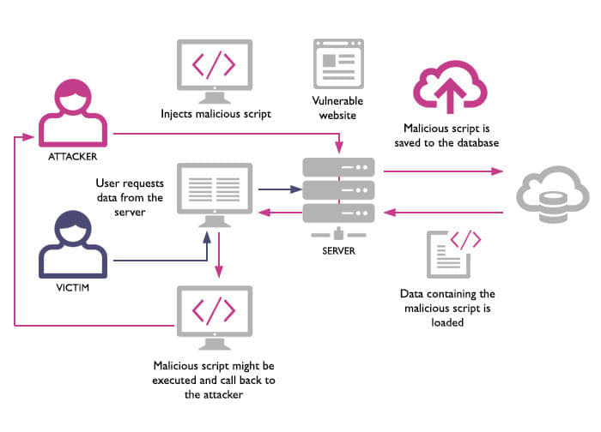
Persistent XSS

Slide 35
Often, XSS is delivered through special attributes instead of script tags.

Slide 36
Certain HTML attributes can execute JavaScript:
<img src=“bad link” onerror=“alert(‘hacked!’)”>

Slide 37
Demo
‘Attribute Attacks’

Slide 38
Activity: Persistent XSS and Attribute Attacks (20 min.)
Overview
In this exercise, you’ll use DVWA and Gruyere to explore persistent XSS vulnerabilities and
Instructions
Open your Gruyere instance by opening: https://google-gruyere.appspot.com/start
Click on Home. Find your username on the page, and note the font color.
Click on Profile. Change the Color to red. Note how the font color changes.
Right-click your name, then select Inspect Element.
Where did the color you entered on your profile get echoed onto the page?
Use your answer to the above to get an onmouseover="alert(1)" attribute into the page.
Hint: You'll have to save this payload through the Color field on your Profile.
Notes:
Slack out the instructions in Activities/Stu_Attacking_with_Attributes/README.md.

Slide 39
Review
‘Attribute Attacks’

Slide 40
FIN

